Slide 1
Year 10 Careers Week
Choices
Subjects
Strengths
interests

Slide 2
During the CEIAG week you will:
think about some important decisions you have to make this year
learn about GCSE courses at Hunterhouse College and talk to teachers/students about these courses
meet the school’s Careers Adviser and learn about how to make good decisions about careers and courses
research some careers which are of interest to you

Slide 3
Career Planning Cycle

Slide 4
Individual Career Planning
This week is your opportunity to explore careers that are of interest to you.
You will have the opportunity to:
Research any career ideas you have
Generate some ideas using research tools
Consider subjects you might require for a future career

Slide 5
Use your booklet to:
Take notes
Record your general research
Record your subject research
Complete the research tasks

Slide 6
Career’s Adviser – Mrs. Colette McGlade
PowerPoint to watch during Form Time

Slide 7
What do I need to find out about subjects…..
What careers need this subject?
What topics do I learn in this subject?
What skills do I need to succeed in this subject?
Is there a lot of controlled assessment?
Does this subject link well to any others?

Slide 8
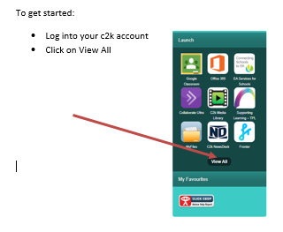
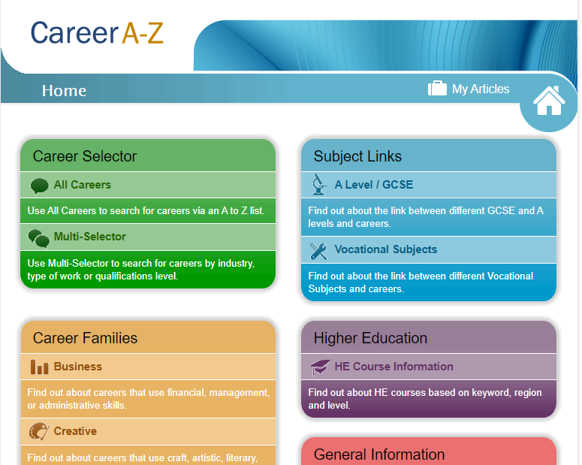
Career Research – ICT Lesson

