Slide 1
Welcome
Sixth Form Virtual Open Event
Mrs N. Shaw,
Head of Sixth Form

Slide 2
Support and Guidance
Mr Gibson
Principal
Sixth Form Study Supervisor
CEIAG + Careers Service
Mr Gilmore
Senior Manager
Post 16 Form Teachers
Learning Guidance
Interviews
Mrs Kane
Vice Principal
Miss Gribbons
SENCO
Assertive Mentoring
Mrs Shaw
Head of Sixth Form
UCAS Tutors
Family
Works Counselling

Slide 3
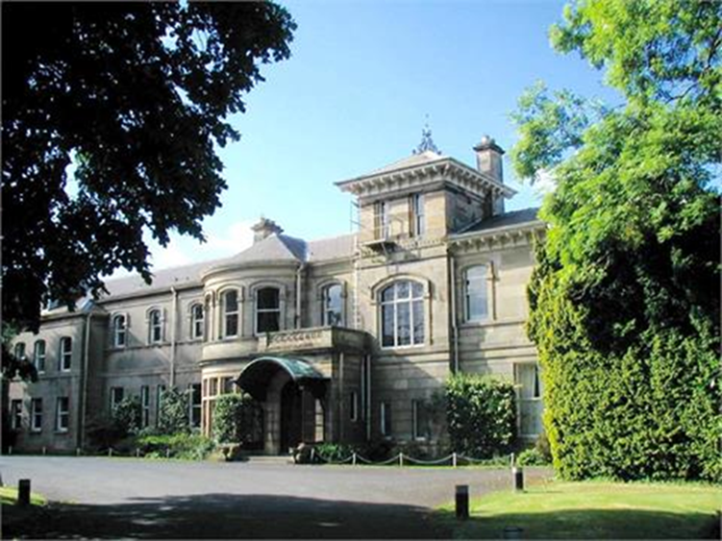
A Different Experience of School
Vertical Tutor Groups
Independent Study
Personal Development Programme (including Lecture Time/E-Progress)
Community Placement and Work Experience (CEIAG Department)
Student Leadership opportunities
Dedicated Sixth Form Study and Social Areas
Privileges

Slide 4
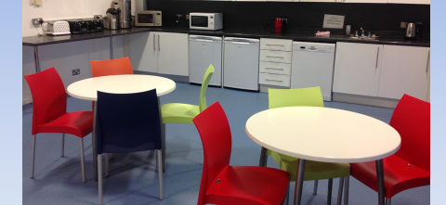
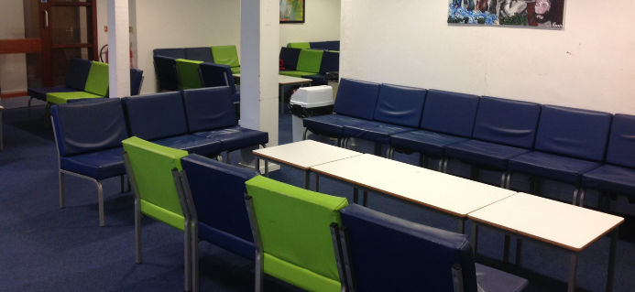
Sixth Form at Hunterhouse College
Sixth Form Study
Sixth Form Social Area
Learning Resource Centre LRC
Careers Zone
Redwood Centre Restaurant

Slide 5
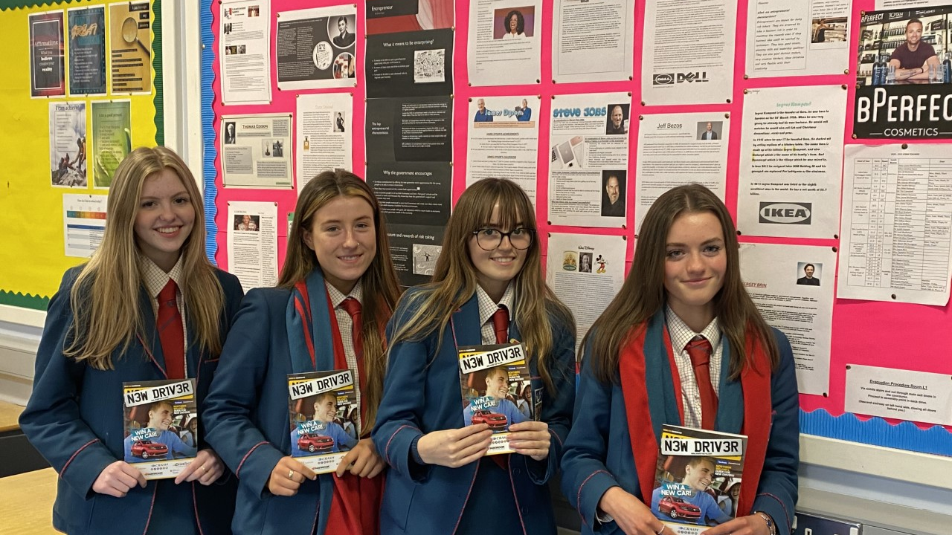
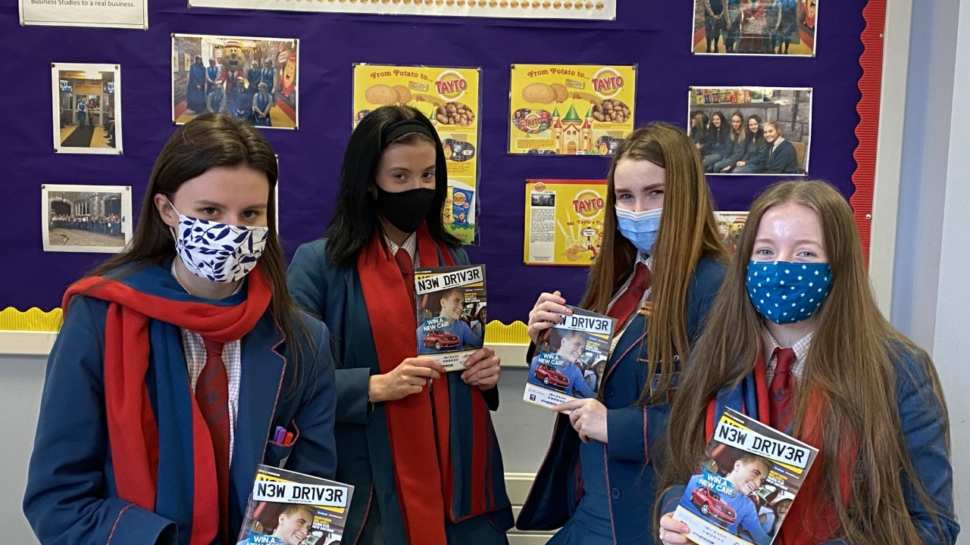
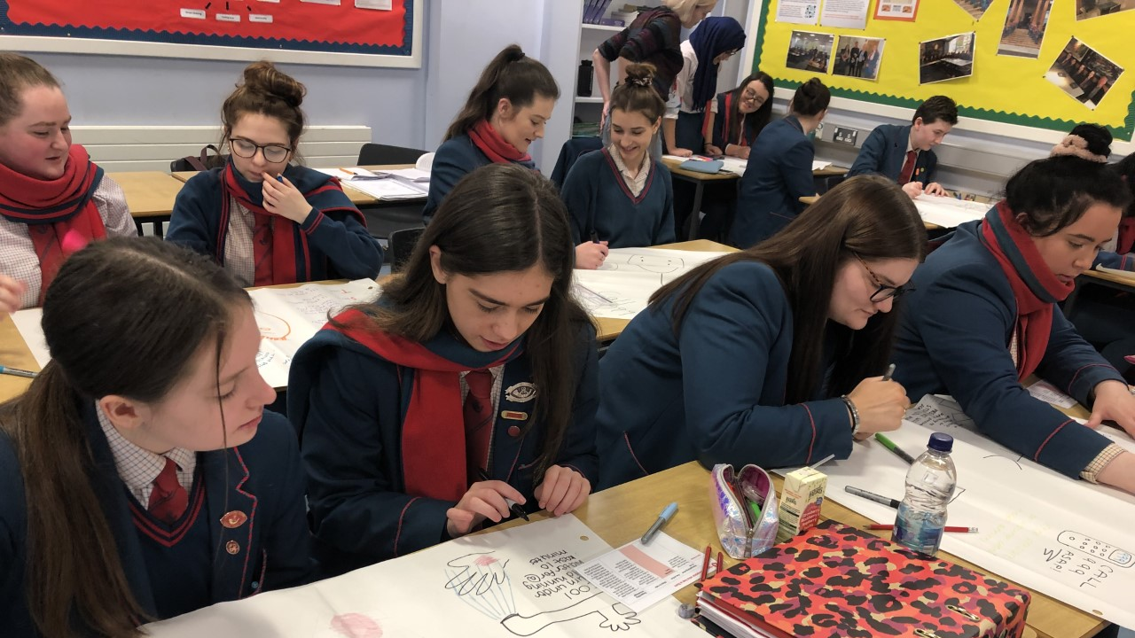
Uniqueness of Sixth Form at Hunterhouse College

